Slide 1
ISO27001:2013 Controls Appendix; Part 8
In this module lets look at ISO27001:2013 (ISMS) related to operations security…

Slide 2
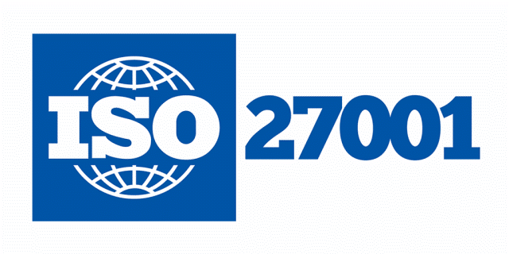
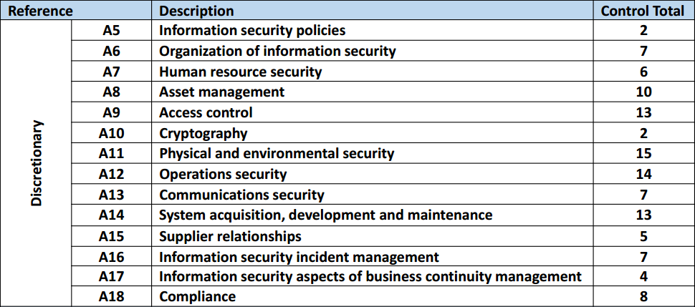
ISO27001:2013 Controls Appendix; Part 8
ISO27001:2013 DISCRETIONARY CONTROLS
TOTAL: 114
https://chapters.theiia.org/bermuda/Events/ChapterDocuments/Information%20Security%20Management%20System%20%28ISMS%29%20Overview.pdf

Slide 3
ISO27001:2013 Controls Appendix; Part 8
A.13 COMMUNICATIONS SECURITY
A.13.1 COMMUNICATIONS SECURITY
A.13.1.1 | NETWORK CONTROLS
A.13.1.2 | SECURITY OF NETWORK SERVICES
A.13.1.3 | SEGREGATION IN NETWORKS

Slide 4
ISO27001:2013 Controls Appendix; Part 8
A.13 COMMUNICATIONS SECURITY
A.13.1.1 | NETWORK CONTROLS | Control: Networks shall be managed and controlled to protect information in systems and applications.

Slide 5
ISO27001:2013 Controls Appendix; Part 8
A.13 COMMUNICATIONS SECURITY
A.13.1.2 | SECURITY OF NETWORK SERVICES | Control: Security mechanisms, service levels and management requirements of all network services shall be identified and included in network services agreements, whether these services are provided in-house or outsourced.

Slide 6
ISO27001:2013 Controls Appendix; Part 8
A.13 COMMUNICATIONS SECURITY
A.13.1.3 | SEGREGATION IN NETWORKS | Control: Groups of information services, users and information systems shall be segregated on networks.

Slide 7
ISO27001:2013 Controls Appendix; Part 8
A.13 COMMUNICATIONS SECURITY
A.13.2 INFORMATION TRANSFER
A.13.2.1 | INFORMATION TRANSFER POLICIES & PROCEDURES
A.13.2.2 | AGREEMENTS ON INFORMATION TRANSFER
A.13.2.3 | ELECTRONIC MESSAGING
A.13.2.4 | CONFIDENTIALITY OR NON-DISCLOSURE AGREEMENTS

Slide 8
ISO27001:2013 Controls Appendix; Part 8
A.13 COMMUNICATIONS SECURITY
A.13.2.1 | INFORMATION TRANSFER POLICIES & PROCEDURES | Control: Formal transfer policies, procedures and controls shall be in place to protect the transfer of information through the use of all types of communication facilities.

Slide 9
ISO27001:2013 Controls Appendix; Part 8
A.13 COMMUNICATIONS SECURITY
A.13.2.2 | AGREEMENTS ON INFORMATION TRANSFER | Control: Agreements shall address the secure transfer of business information between the organization and external parties.

Slide 10
ISO27001:2013 Controls Appendix; Part 8
Lets look at system acquisition, development & maintenance in the next module…
END

